Slide 1
LLM-based Software Contract Checker
Sectorlens
09.07.2025

Slide 2
Agenda
Motivation
Make Data Accessible
Preprocess Data
Mapping Approach
Label Data Corpus
Model Selection
Finetuning and Classifier building
Automated Contract Evaluation

Slide 3
Motivation

Slide 4
What is the task?
Objective:
Develop an automated system for reviewing software contracts
Systems core functionalities:
Standard compliance check
Contract assessment
Risk identification

Slide 5
Why Automate Contract Checking?
Our Goals:
Detect whether key legal clauses are present
Evaluate if a paragraph truly fulfills its legal purpose
Support scalable and explainable contract analysis
Use modern NLP to assist, not replace, legal experts
Challenges:
Contracts are complex and long—often dozens of pages
Legal review is manual and costly, relying on expert knowledge
Important clauses may be missing, especially in templates
Lack of consistent structure makes comparison difficult

Slide 6

The Real-World Problem
Contracts are reused but rarely uniform
Manual review is time-consuming and costly
Missing clauses → legal, financial, compliance risk
Volume makes consistent checks unscalable

Slide 7
Why NLP?
Contracts = structured natural language
Transformer models capture meaning, not just keywords
Embeddings help match text to example clauses
LLMs rate fulfillment quality (e.g., GPT-based scoring)
1
2
3
4
Contract Text
Embedding
Clause Match
GPT Scoring

Slide 8

Our Goal with this Project
Support (legal) teams with intelligent suggestions
Spot gaps, unclear phrasing, or mismatches
Combine structured catalogue + example text + LLM
Bring explainability to contract automation

Slide 9
What’s missing in existing tools
Most tools check for clause presence only (keyword matching)
No semantic understanding or context-awareness
Rarely customizable to new contract types or domains
Lack of transparency → “black box” risk in legal workflows

Slide 10
Our Solution Adds Value By:
Automating routine legal checks
Reducing time and cost of contract evaluation
Improving reliability through standardized review
Supporting risk mitigation with early detection of problematic clauses

Slide 11
2. Make Data Accessible

Slide 12
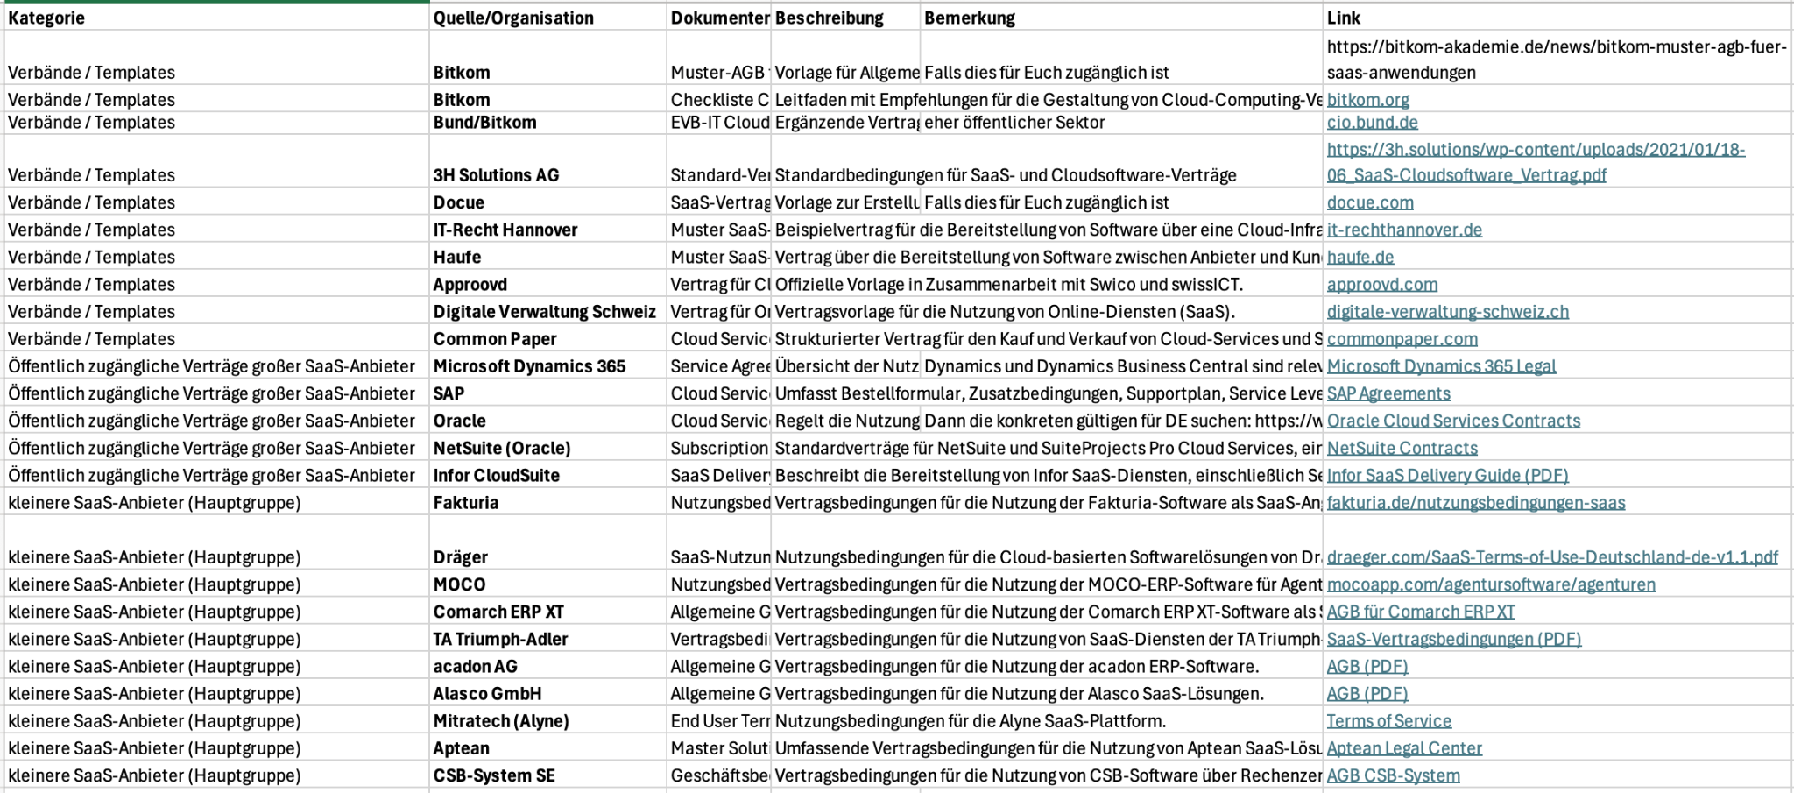
Provided access to data

Slide 13
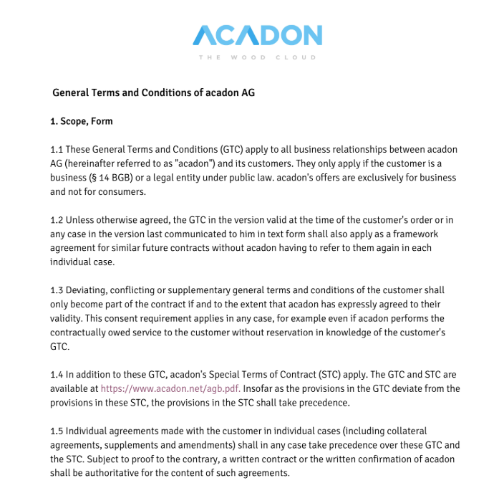
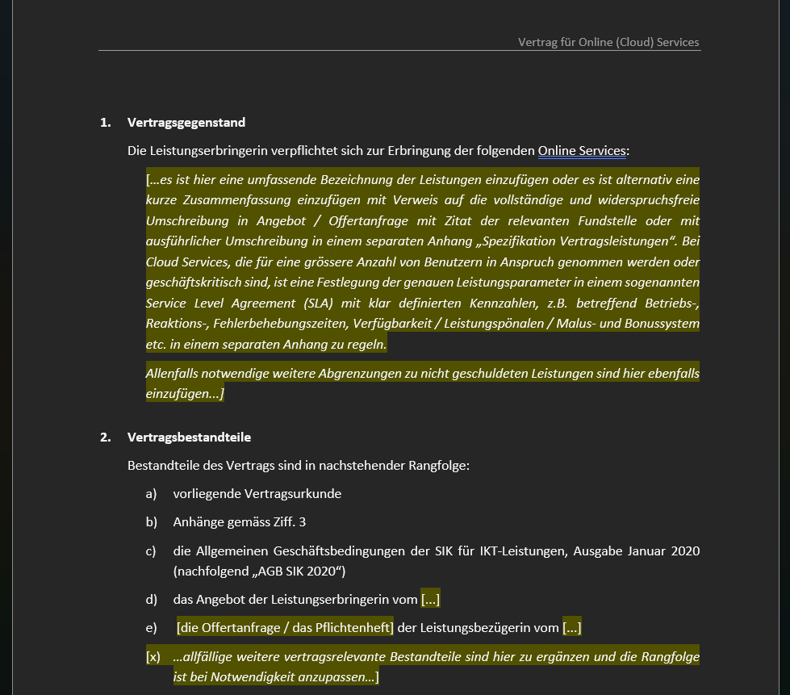
How does the data look like?
Contract documents in various formats (PDF, DOCX, HTML)
PDF
DOCX

Slide 14
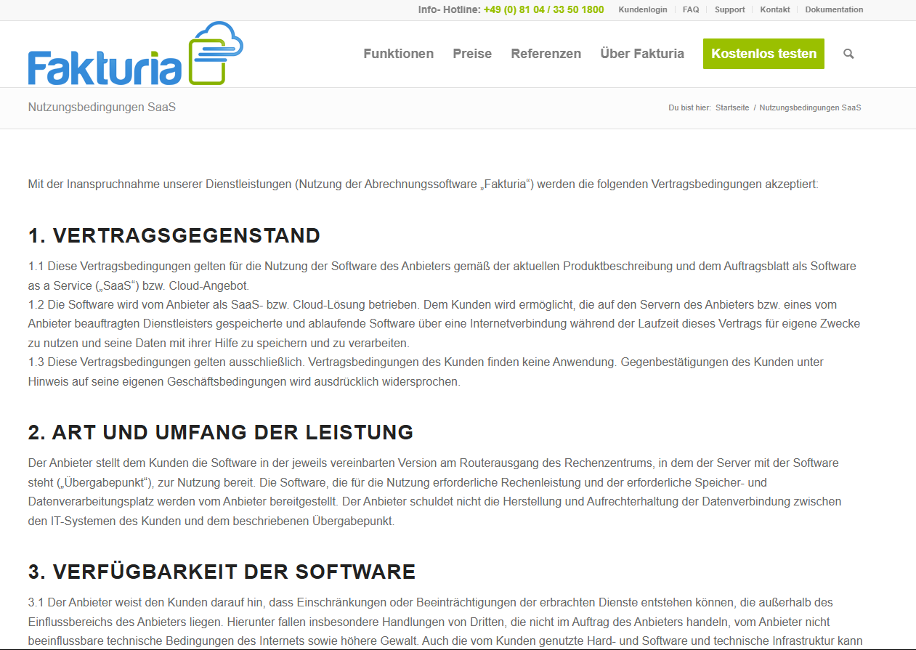
How does the data look like?
Contract documents in various formats (PDF, DOCX, HTML)
HTML

Slide 15
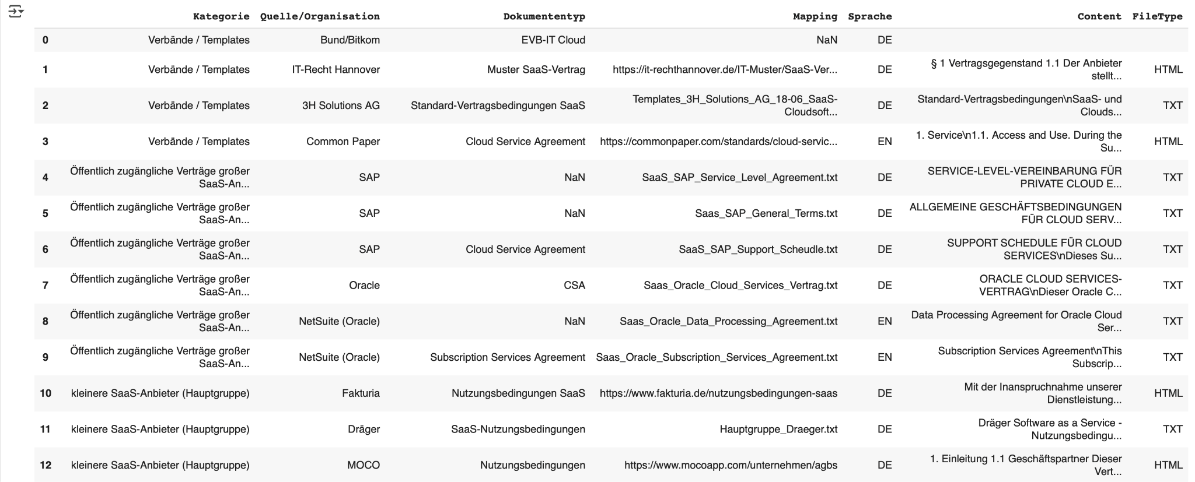
Raw Data Dataframe

Slide 16
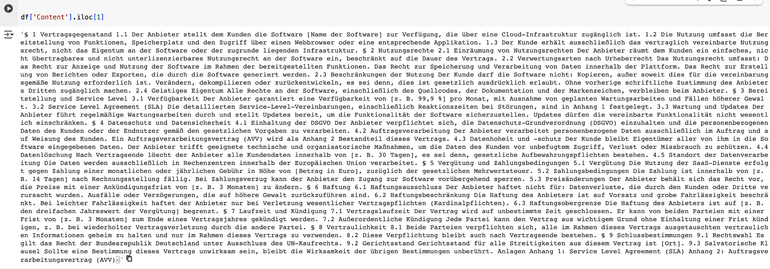
Example Content Column

Slide 17
3. Preprocess Data

Slide 18
2.1 Structure
Contract | Paragraph | Section
1 | 1. Scope Form | 1.1
1 | 1. Scope Form | 1.2
1 | 1. Scope Form | 1.3
1 | 1. Scope Form | 1.4
1 | 1. Scope Form | 1.5

Slide 19
2.2 Preprocessing Pipeline
Paragraph =
'(§\s*\d+|^\d+\.)\s+'
Section =
'(?:(?<=\s)|(?<=^))({para_num}\.\d+)(?:\.|\b)(?=\s)'
structuring

Slide 20
2.3 Preprocessing Pipeline
# 1. remove paragraph marker
# 2. Converting all text to lowercase
# 3. Stripping HTML tags
# 4. Removing numbers
# 5. Removing punctuation
# 6. tokenization
2. Cleaning
Paragraphs and sections

Slide 21
2.5 Result Corpus

Slide 22
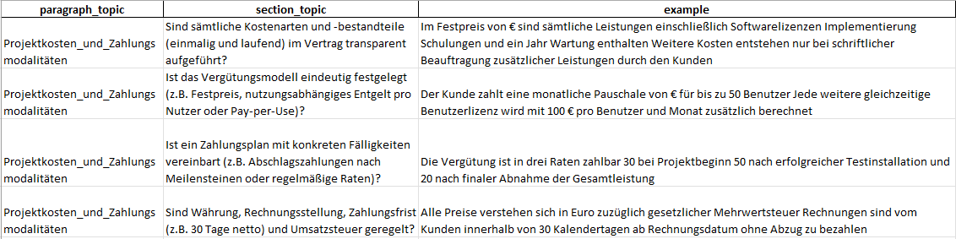
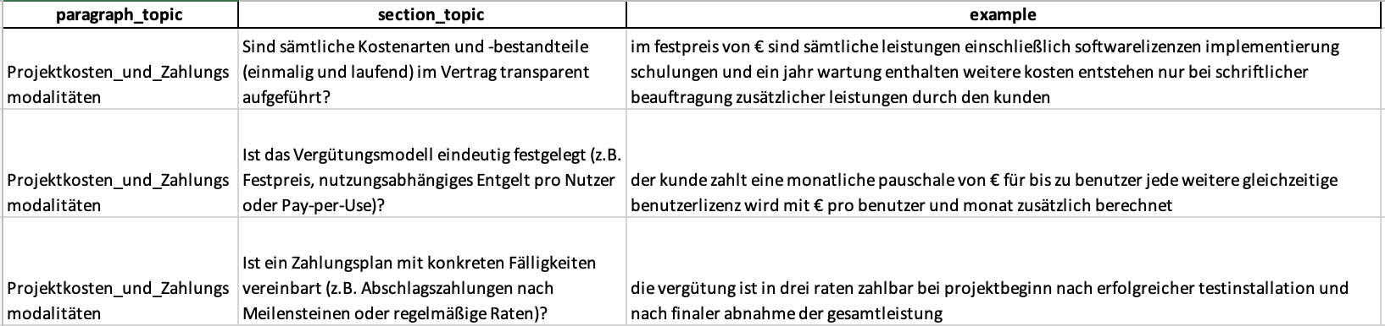
2.5 Result Requirements Catalogue

Slide 23
4. Mapping Approach

Slide 24
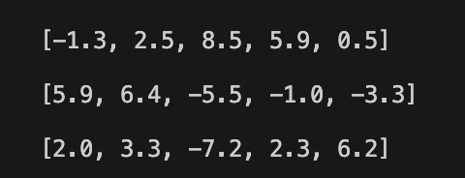

Mapping Approach
 | example
Req 1 | „Der Anbieter liefert im Rahmen …”
Req 2 | „Der Kunde zahlt eine monatliche Paus…”
Req 3 | „Die Vergütung ist in drei Raten zahl…”
„die nutzung umfasst die bereitstellung von funktionen speicherplatz und den zugriff über einen webbrowser oder eine entsprechende applikation…”
0.685
0.009
0.260

Slide 25
4 Steps to the final predictor
1. Label the corpus of sections
2. Select a suited pretrained model
3. Build a model for cosine similarity calculation
(+ finetuning)
4. Expand the model for predicting topics

Slide 26


Labeling
2. Manual Mapping
→ Pros:
No Dataleakage
No additional manual checking needed
→ Cons:
Takes a lot of time and effort
Less data available
Cosine Similarity
→ Pros:
Less manual effort
Relatively fast
More data available
→ Cons:
Dataleakage

Slide 27
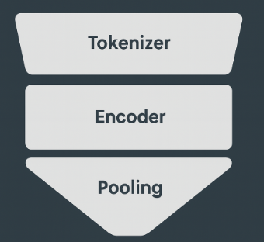
Embedding Model Selection
„die nutzung umfasst die bereitstellung von funktionen speicherplatz und den…”
MODELS
Gbert-base
paraphrase-multilingual-MiniLM-L12-v2
Bert-base-uncased
Jina-embeddings-v2-small-en
jina-embeddings-v2-base-de
Tokenizer
{
Encoder
Pooling strategies
CLS
MEAN
MAX
Embedding: [5.0, 5.8, 6.7, 5.1, 7.1]

Slide 28
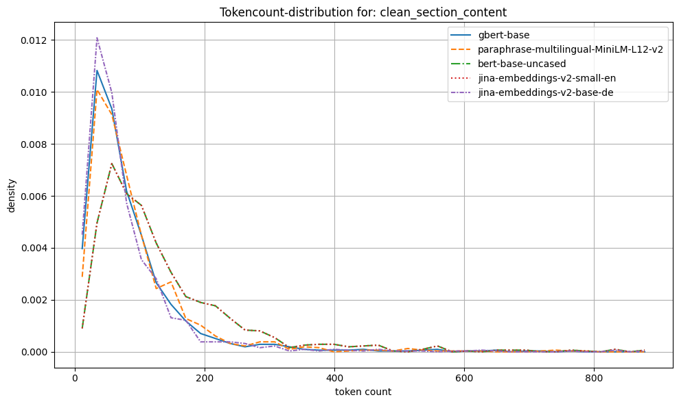
Tokenizer

Slide 29
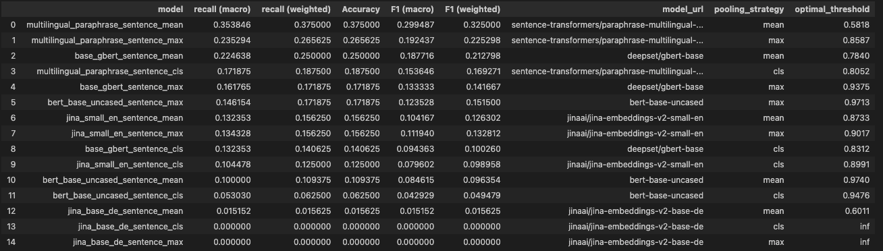
Model evaluation

Slide 30
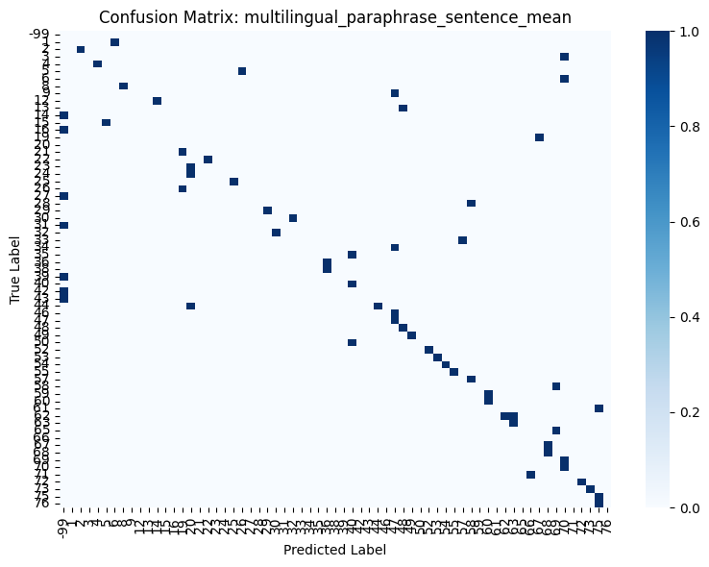
Model

Slide 31
Model Description
BertModel(
(embeddings): BertEmbeddings(
(word_embeddings): Embedding(250037, 384, padding_idx=0)
(position_embeddings): Embedding(512, 384)
(token_type_embeddings): Embedding(2, 384)
(LayerNorm): LayerNorm((384,), eps=1e-12, elementwise_affine=True)
(dropout): Dropout(p=0.1, inplace=False)
)
(encoder): BertEncoder(
(layer): ModuleList(
(0-11): 12 x BertLayer(
(attention): BertAttention(
(self): BertSelfAttention(
(query): Linear(in_features=384, out_features=384, bias=True)
(key): Linear(in_features=384, out_features=384, bias=True)
(value): Linear(in_features=384, out_features=384, bias=True)
(dropout): Dropout(p=0.1, inplace=False)
)
(output): BertSelfOutput(
(dense): Linear(in_features=384, out_features=384, bias=True)
(LayerNorm): LayerNorm((384,), eps=1e-12, elementwise_affine=True)
(dropout): Dropout(p=0.1, inplace=False)
)
)
(intermediate): BertIntermediate(
(dense): Linear(in_features=384, out_features=1536, bias=True)
(intermediate_act_fn): GELUActivation()
)
(output): BertOutput(
(dense): Linear(in_features=1536, out_features=384, bias=True)
(LayerNorm): LayerNorm((384,), eps=1e-12, elementwise_affine=True)
(dropout): Dropout(p=0.1, inplace=False)
)
)
)
)
Tokenizer:
paraphrase-multilingual-MiniLM-L12-v2
Encoder:
paraphrase-multilingual-MiniLM-L12-v2
Pooling: Mean
Notes:
Merkmal
Dein Modell (z. B. MiniLM o.ä.)
bert-base-uncased
Vokabulargröße
250037
30522
Embedding-Dimension
384
768
Padding-Index
0
0
Layergröße allgemein
Klein / effizient
Größer / genauer

Slide 32
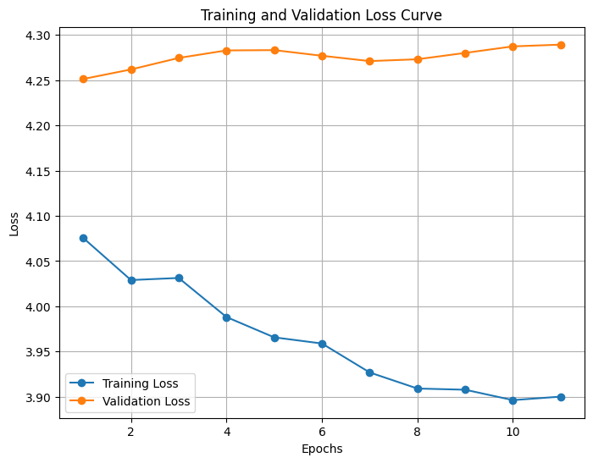
Fine Tuning
64 Sections
Train 70%
Test 15%
Validation 15%
Training duration:
up to 100 epochs
early stopping (patience: 10)
Loss function:
CrossEntropy
Optimizer:
AdamW

Slide 33
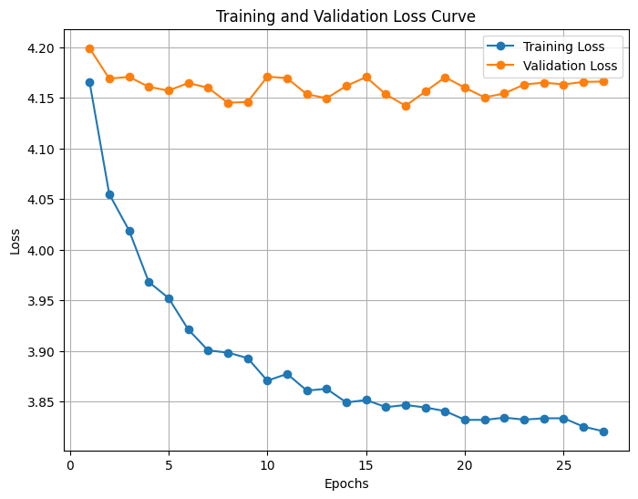
Fine Tuning
64 Sections
Train 80%
Test 0%
Validation 20%
Training duration:
up to 100 epochs
early stopping (patience: 10)
Loss function:
CrossEntropy
Optimizer:
AdamW

Slide 34
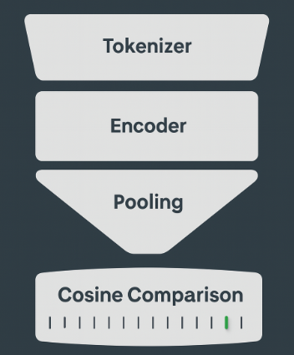
Predictor
„die nutzung umfasst die bereitstellung von funktionen speicherplatz und den…”
Tokenizer
Encoder
Encoder -Model
Pooling
Cosine Comparison
I I I I I I I I I I I I I I I
Prediction Method
Cosine Similarities: [0.2, 0.73, -0.5, 0.6, -0.12, -0.22, 0.74, 0.95, -0.3]

Slide 35
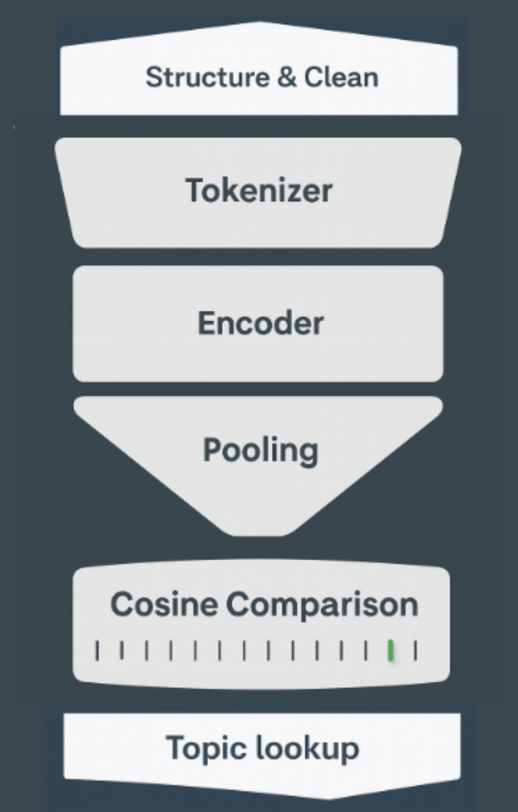
Classifier
SaaS Contract
Tokenizer
Structure & Clean
$ | Section | Predicted topic
§1 | Section 1 | Topic 7
… | … | …
§2 | Section 2 | Topic 3
… | … | …
§4 | Section 4 | Topic 3
Encoder
Encoder -Model
+
Prediction Method
Pooling
Cosine Comparison
I I I I I I I I I I I I I I I I I
Topic lookup

Slide 36
5. Automated Contract Evaluation

Slide 37
Define Core Aspects
Goal: define objective core aspects that can be used universally
How: by generating clear prompts for each section topic
Steps:
Extract paragraph_topic, section_topic and example phrase from catalogue
Develop objective prompts for creating individual core aspects for each section_topic
Using prompts to acquire core_aspects and insert into table

Slide 38
Define Core Aspects
Step 2: Prompt developing
Welche objektiv prüfbaren Kernaspekte enthält folgende Anforderung: "Gibt es einen schriftlichen Projektzeitplan mit definierten Phasen, Meilensteinen und Terminen?"? Formuliere die Antwort als Liste von inhaltlichen Prüfpunkten, die unabhängig vom konkreten Vertragstext verwendet werden kann. Nutze das Beispiel zur Orientierung: "Der Projektzeitplan wird als Anlage 2 festgeschrieben Wichtige Meilensteine sind Abschluss der Konzeptphase bis 3103 Fertigstellung der Implementierung bis 3107 Beginn Integrationstest am 1508 GoLive zum 0110 Konkrete Meilensteinziele und termine sind dem Plan in Anlage 2 zu entnehmen".
Which objectively verifiable core aspects are included in the following requirement: "Is there a written project schedule with defined phases, milestones, and deadlines?" Formulate the answer as a list of content-related checkpoints that can be used independently of the specific contract wording. Use the example as guidance: “The project schedule is defined in Annex 2. Important milestones include the end of the concept phase by 3103, completion of implementation by 3107, start of integration testing at 1508, and GoLive at 0110. Specific milestone goals and deadlines can be found in the schedule in Annex 2."
Task
Instruction
Example

Slide 39
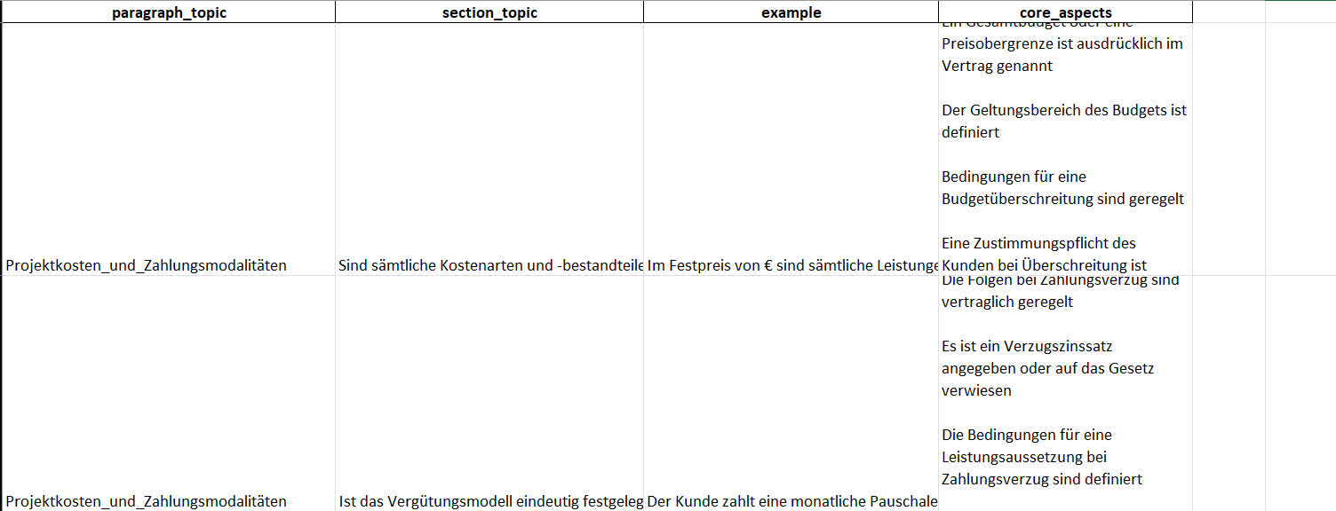
Define Core Aspects
Step 3: core_aspects

Slide 40
Contract Evaluation
Goal: Evaluate how well contract sections fulfill their expected core aspects
How: by prompting an LLM with each section and its core aspects
Steps:
Create prompt with section content and list of core aspects
Merge predicted section topics with core aspects
Prepare LLM evaluation
Evaluate sample of sections with OpenAI API
Parse evaluation results

Slide 41
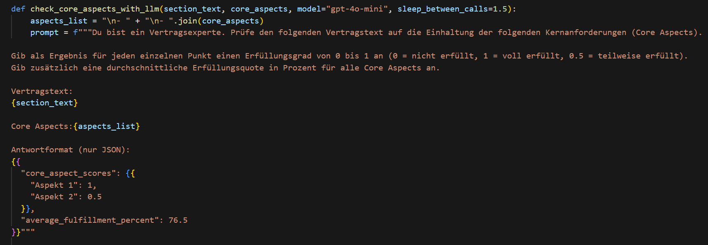
Contract Evaluation
Step 1: prompt with section content and list of core aspects

Slide 42
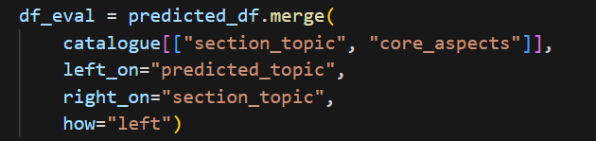
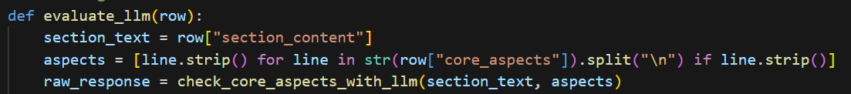
Contract Evaluation
Step 2: Join predicted topics with core aspects
Step 3: Prepare LLM evaluation

Slide 43
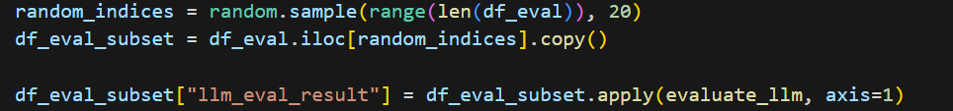
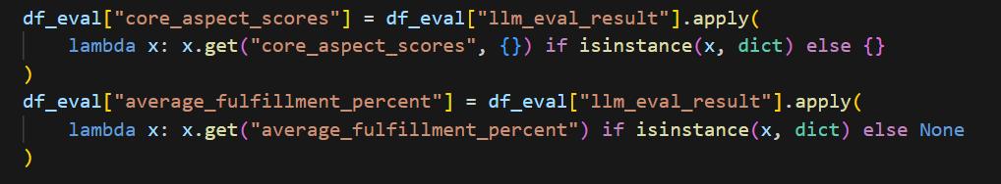
Contract Evaluation
Step 4: Evaluate sample
Step 5: Parse evaluation results

Slide 44
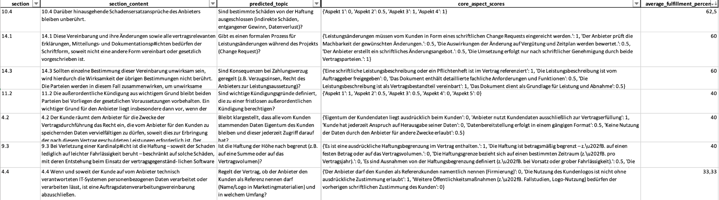
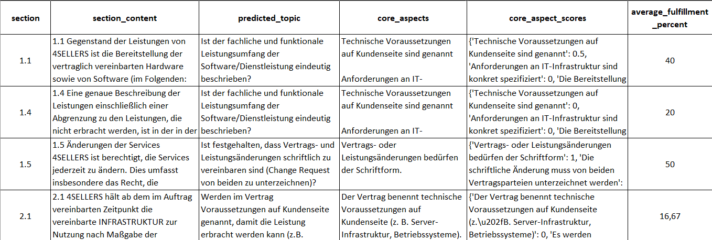
Contract Evaluation
Result:

Slide 45
Next Steps - Current approach
Legal feedback on GPT scoring accuracy (expert review to assess quality)
Expand the prompt-based catalog (add more examples, restructure catalog)
Need more labeled data (ideally from experts)
Add fallback logic and thresholds to improve robustness (enhance pipeline with error handling + automation)
Compare more LLMs (Claude, Gemini, etc.) and run large-scale evaluations
Detect anomalies or suspicious matches
Including the Classifier and the GPT scoring into one “Contract Checker” Class
Notes:
Another key next step is detecting anomalies or suspicious matches. Even with strong embeddings and GPT evaluations, there can be cases where a clause is matched—but doesn’t actually make sense in the contract’s context.

Slide 46
Long-Term Outlook
Use explainable AI, not black-box decisions (ensure accountability)
Adapt across domains: SaaS, employment, NDAs, languages etc. (scale across contract types)
Learning from user input - correction on predicted labels (reinforcement learning)

Slide 47
Thank you!

Slide 48
Backlog

Slide 49
4 Steps to the final perdictor
1. Labeled Dataset for Eval, Train & Test
2. Encoder Model for Embeddings
3. Cosine similarity
section→ requirement
4. Prediction of most similar requirement
1. Label the corpus of sections
2. Select a suited pretrained model + finetuning
3. Build a model for cosine similarity calculation
4. Expand the model for predicting topics

Slide 50
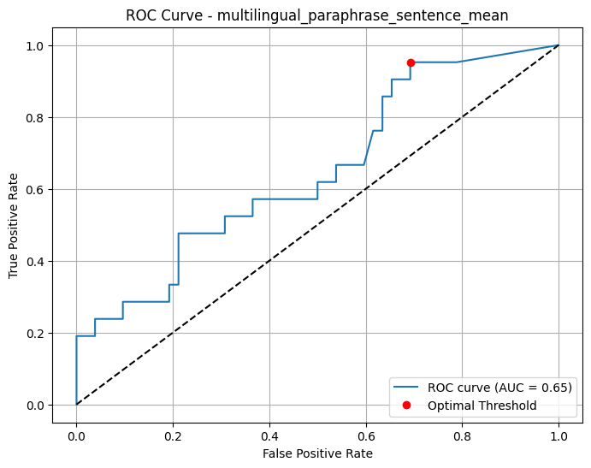
The Threshold

Slide 51
What do we need for this approach?
1. Labeled Dataset for Eval, Train & Test
2. Encoder Model for Embeddings
3. Cosine similarity
section→ requirement
4. Prediction of most similar requirement

Slide 52
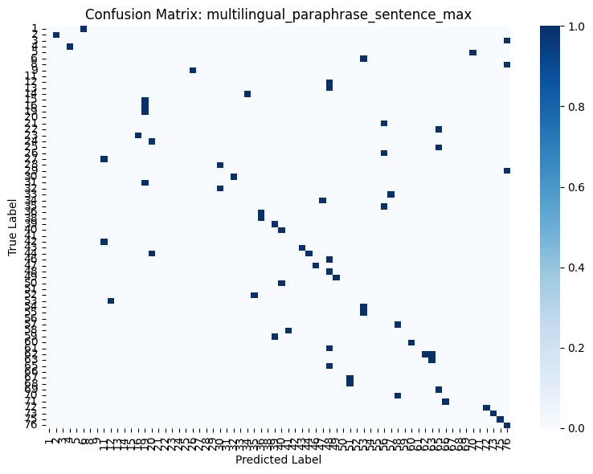
Model evaluation

